Slide 1
CAR Administration Overview
Module 2 – Responsibilities and CAR Ownership

Slide 2
Who’s the CAR Administrator?

Slide 3
Who’s the CAR Administrator?
Local CARs are administered by Local CAR Administrators
Corporate CARs are administered by Corporate CAR Administrators
“Field Report” CARs are administered by that group
CAR Source of “Field Report – CAS” are administered by Global Quality to assign ownership, then administered by local administrator
**NEW** CARs with the Owner’s Subregion of “Global Field Operations” are administered by their group.
CAR Source of “IECEE-CBTL” in North America are administered by Jola W.

Slide 4
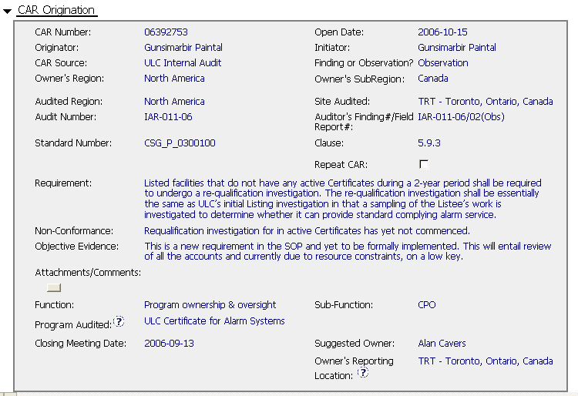
Who’s the CAR Administrator?
Local CARs are administered by Local CAR Administrators

Slide 5
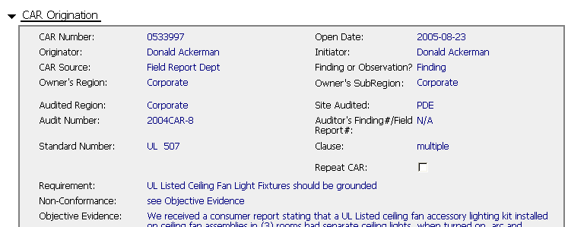
Who’s the CAR Administrator?
CARs with CAR Source of “Field Report Dept” are administered by that group

Slide 6
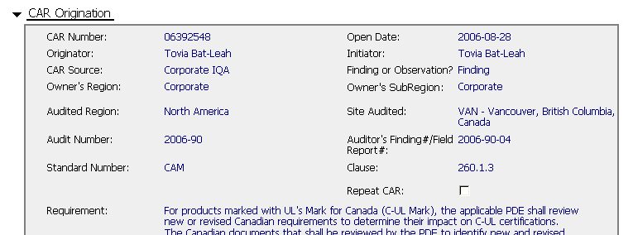
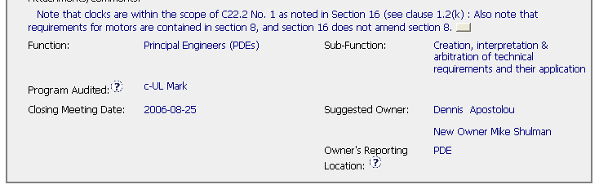




Who’s the CAR Administrator?
CARs for Corporate functions (PDE, CPO, GIFS, CSP, Operations) along with CARs owned by RQMs and senior managers, are administered by Corporate Quality Engineering

Slide 7
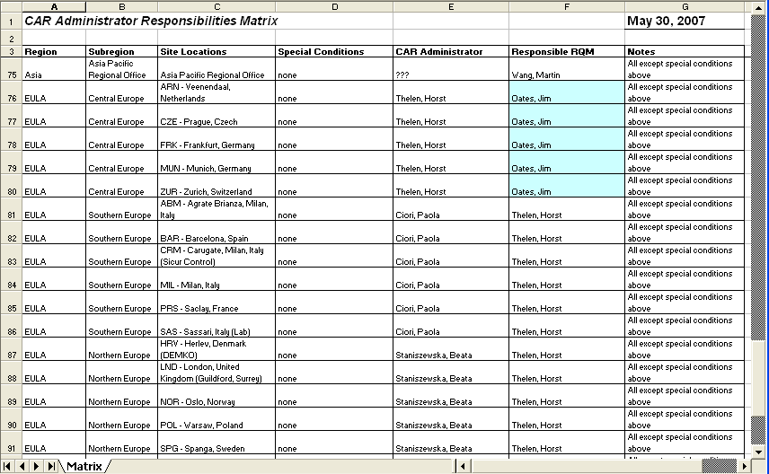
REFERENCE:
CAR Administration Matrix – In Team Room
Shows who administers CARs based on Owner’s location and other attributes

Slide 8
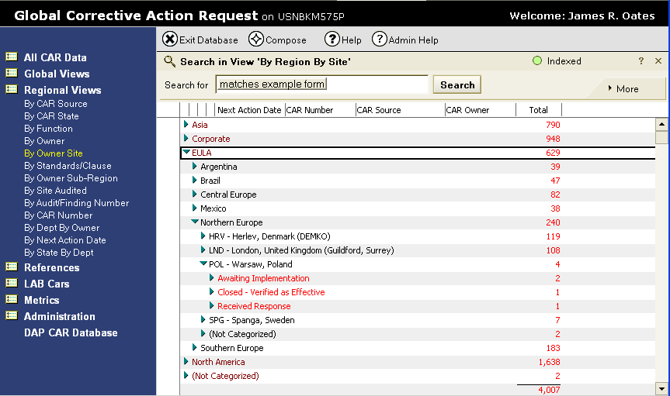
Identifying CARs for Administration in the Tool
Under “Regional Views”
use view “By Owner Site”

Slide 9
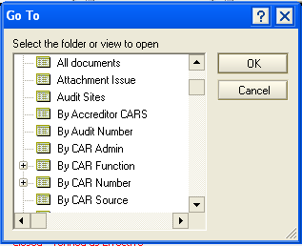
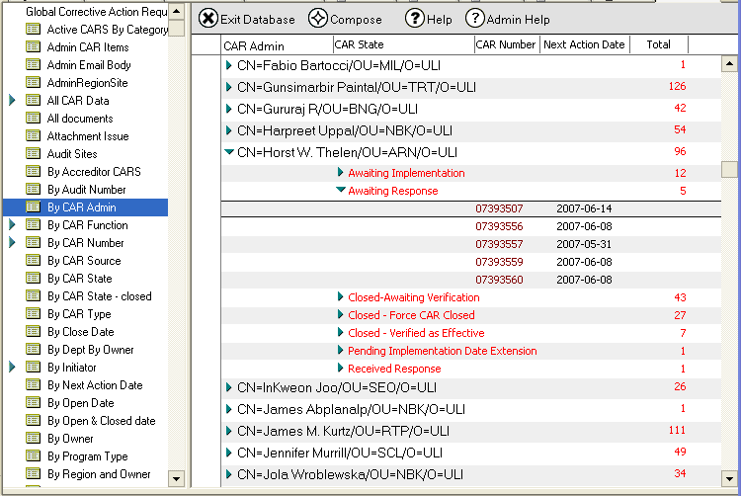
View → Go To → By CAR Admin
Shows a view of all CARs by listed CAR Administrator
If two administrators are listed in a CAR, the CAR appears under both administrators.

Slide 10
CAR Ownership

Slide 11
CAR Ownership
The CAR Owner should be
  Responsible for the function
  Accountable to resolve the issue
  Authorized to make the changes
Notes:
Before we get into the nuts and bolts of CARs, I wanted to briefly talk about CAR ownership.
We have also struggled with CAR ownership, sometimes forgetting these fundamental rules that should determine who the CAR owner should be

Slide 12
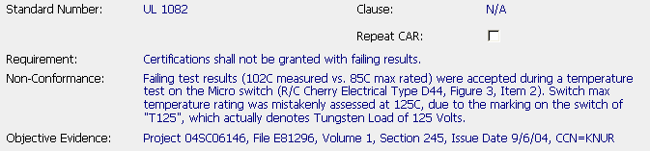
Example – CAR Owner
Who should be the CAR Owner?

Slide 13
Example – CAR Owner
  Reviewer did not identify failing result during Final Review
  Project Handler did not identify failing result before submitting for Final Review
  Failing result first appeared in the Laboratory

Slide 14
Ownership Philosophy
Local compliance issues. . .
  . . .assigned to the SITE MANAGER/ SECTOR LEAD/ GENERAL MANAGER
Process issues. . .
  . . .assigned to the PROCESS OWNER
Policy issues. . .
  . . .assigned to the POLICY OWNER
Most CARs begin as Local Compliance Issues – Investigation needed to determine if issue is related to Process or Policy deficiencies
Notes:
To address this problem, we have adjusted our CAR ownership philosophy

Slide 15
Example – CAR Owner
  Reviewer did not identify failing result during Final Review
  Project Handler did not identify failing result before submitting for Final Review
  Failing result first appeared in the Laboratory

Slide 16

Example – CAR Owner
Suspicions . . .
  Reviewer did not identify failing result during Final Review
  Project Handler did not identify failing result before submitting for Final Review
  Failing result first appeared in the Laboratory
Initial CAR Owner:
SECTOR LEAD

Slide 17
Responsibilities – Owner vs. Administrator
CAR Owner. . .
  . . . has prime responsibility for resolution of the CAR
  . . . identifies and works with key stakeholders, sets up meetings, etc.
  . . . takes the lead to perform the root cause analysis and corrective action plan
  . . . determines the scope of the nonconformance and root cause statement
  . . .develops corrective actions and commits to timeframes for implementation of the plan
  . . . ensures CAR commitments are on time and requests extensions when needed
  . . . overcomes roadblocks and escalates issues to their manager
  . . . enters CAR responses into the CAR Tool.
CAR Administrator. . .
  . . . can assist the CAR Owner and provide guidance during resolution of the CAR
  . . . can assist the CAR Owner to identify the key stakeholders
  . . . as a subject matter expert on root cause analysis, can assist the Owner
  . . . has knowledge of other CARs and can assist the Owner in the analysis
  . . . can help the Owner document their plan and develop effectiveness criteria milestones
  . . . can extend CARs that are Overdue or Escalated states
  . . . has knowledge of other CARs and their solutions and status
  . . . knows how to use the CAR tool and can support CAR Owners on the use.

Slide 18
Control vs. Influence
Universe
Under your Control

Slide 19
Control vs. Influence
Universe
Under your Influence
Under your Control

Slide 20
Control vs. Influence
Universe
Universe
Under your Influence
Under High-Level
Manager’s
Control
Under your Control
Support by a high-level manager can increase your influence

Slide 21
Control vs. Influence
Universe
Under your Influence
Under your Control
Lack of support can diminish your influence

Slide 22
Control vs. Influence
Universe
Under your Influence
Under your Control
Personality, reputation, and other factors can increase your influence

Slide 23

Delegation of Ownership
Purpose – Allows a Sector Lead to designate a member of their staff to follow up on the CAR on their behalf
Document the delegation in the “Attachments/Comments” section of the CAR:
Future CAR Tool Change: Addition of ‘Owner’s Assistant’ field so the CAR Owner can allow another individual to perform ownership functions on their behalf.

Slide 24
Changing CAR Owner
Investigation may show that CAR needs to be reassigned to another individual
Justifications for changing Owners after assignment are to be documented in the Root Cause Analysis section of the CAR.

Slide 25
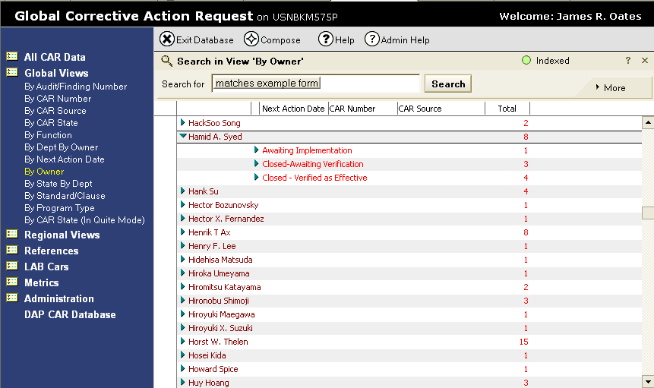
Identifying CARs by Owner in the Tool
Under “Global Views”
use view “By Owner”

Slide 26
Other Required Fields

Slide 27
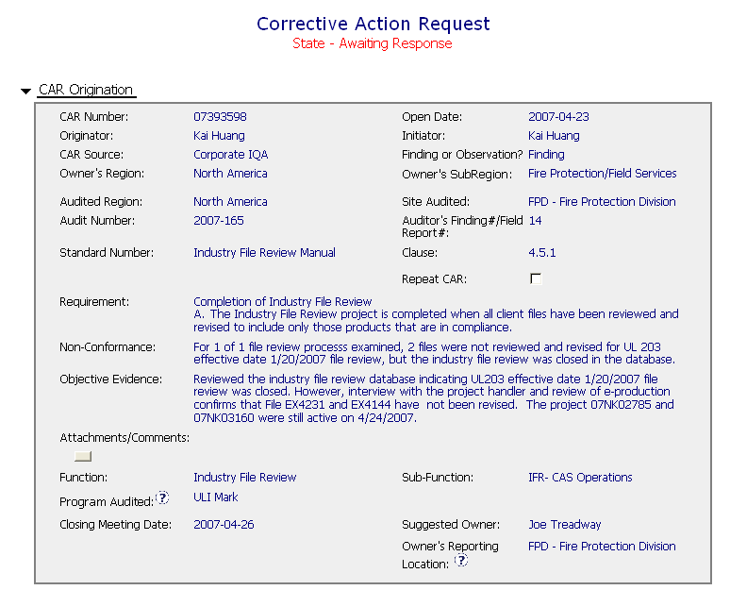
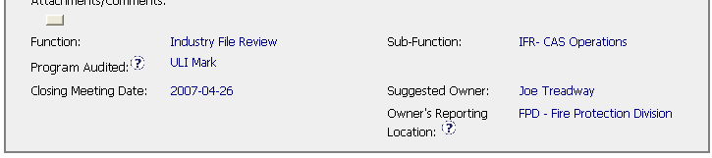
Function, Subfunction, Program Audited
Function & Subfunction: Specific process area where nonconformance occurred (where corrective actions are applied)
Program Affected: Defines the programs affected by this CAR
These are required fields

Slide 28
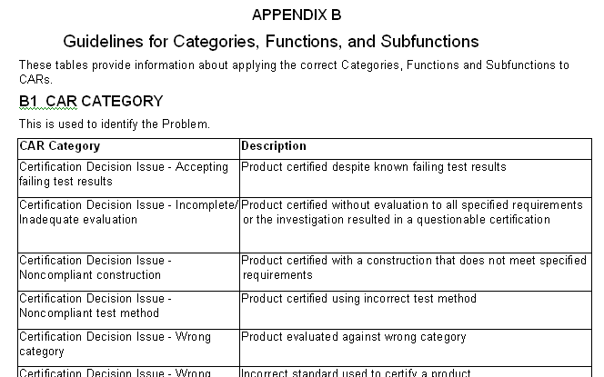
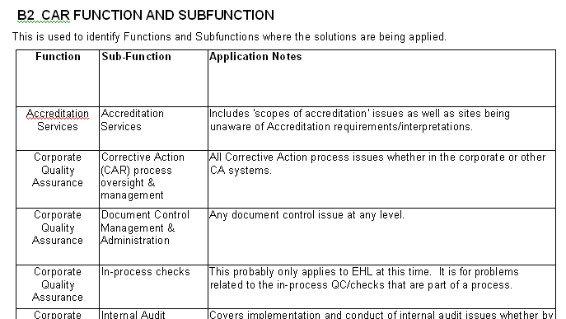
Function, Subfunction, Category –
More information
See 00-QA-S0010 Appendix B
  Details about the CAR Category which categorizes the problem
  Information on application of the Function and Subfunction based on the results of the pilot

Slide 29
End of Module 2
Revision 1.0 – Version presented to EULA team June 2007, complies with 00-QA-S0010 Issue 6.0 and 00-QA-J0029 Issue 1.0.

